Slide 1

CONCEPTS OF PROGRAMMING LANGUAGES
12th Edition
Chapter 15
Functional Programming
Languages

Slide 2
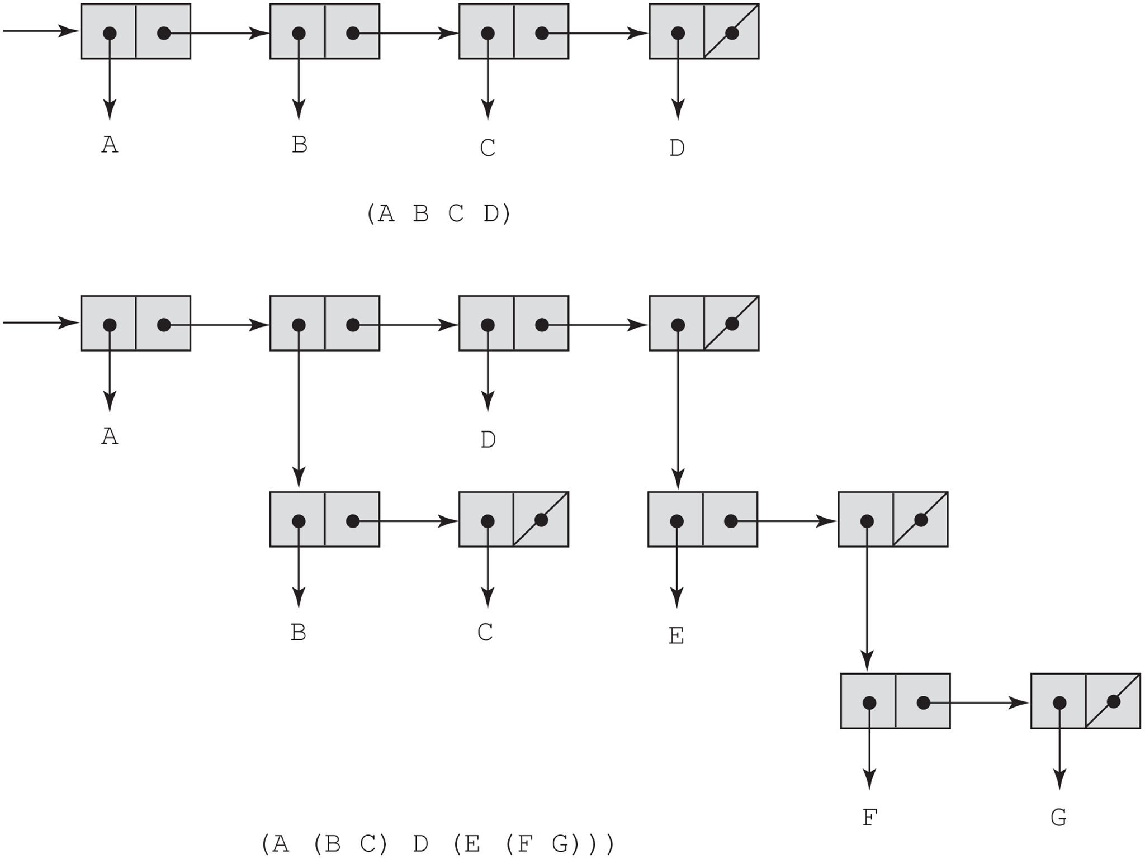
Figure 15-1 Internal representation of two Lisp lists

Slide 3
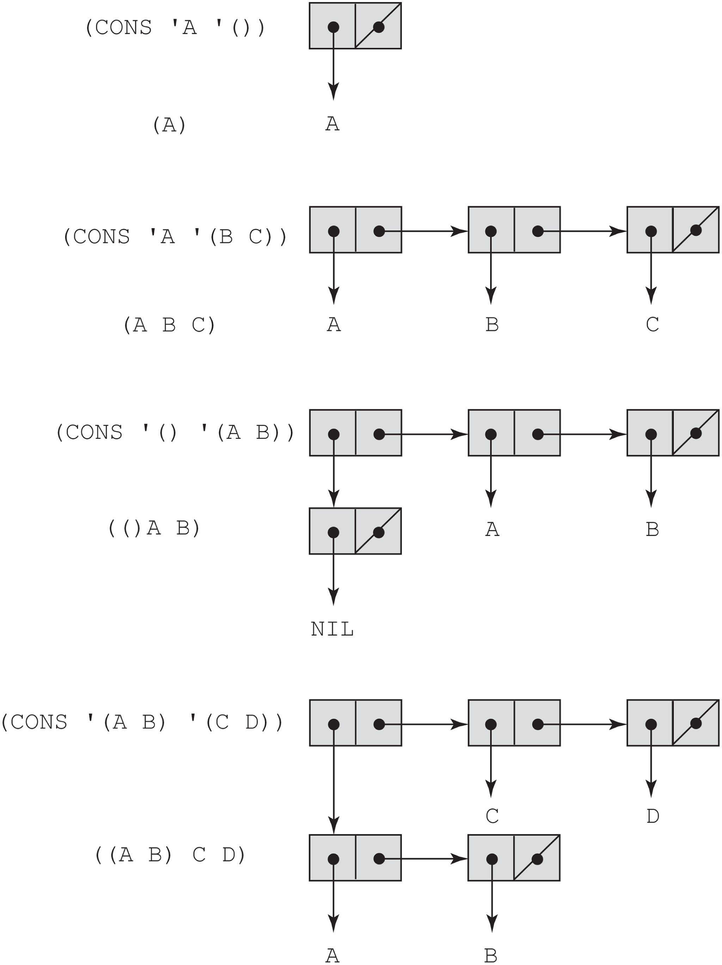
Figure 15-2 The result of several CONS operations

